Slide 1
Data Mining
Practical Machine Learning Tools and Techniques
Slides for Chapter 5, Evaluation
of Data Mining by I. H. Witten, E. Frank,
M. A. Hall and C. J. Pal

Slide 2
Credibility: Evaluating what’s been learned
Issues: training, testing, tuning
Predicting performance: confidence limits
Holdout, cross-validation, bootstrap
Hyperparameter selection
Comparing machine learning schemes
Predicting probabilities
Cost-sensitive evaluation
Evaluating numeric prediction
The minimum description length principle
Model selection using a validation set

Slide 3
Evaluation: the key to success
How predictive is the model we have learned?
Error on the training data is not a good indicator of performance on future data
Otherwise 1-NN would be the optimum classifier!
Simple solution that can be used if a large amount of (labeled) data is available:
Split data into training and test set
However: (labeled) data is usually limited
More sophisticated techniques need to be used

Slide 4
Issues in evaluation
Statistical reliability of estimated differences in performance ( significance tests)
Choice of performance measure:
Number of correct classifications
Accuracy of probability estimates
Error in numeric predictions
Costs assigned to different types of errors
Many practical applications involve costs

Slide 5
Training and testing I
Natural performance measure for classification problems: error rate
Success: instance’s class is predicted correctly
Error: instance’s class is predicted incorrectly
Error rate: proportion of errors made over the whole set of instances
Resubstitution error: error rate obtained by evaluating model on training data
Resubstitution error is (hopelessly) optimistic!

Slide 6
Training and testing II
Test set: independent instances that have played no part in formation of classifier
Assumption: both training data and test data are representative samples of the underlying problem
Test and training data may differ in nature
Example: classifiers built using customer data from two different towns A and B
To estimate performance of classifier from town A in completely new town, test it on data from B

Slide 7
Note on parameter tuning
It is important that the test data is not used in any way to create the classifier
Some learning schemes operate in two stages:
Stage 1: build the basic structure
Stage 2: optimize parameter settings
The test data cannot be used for parameter tuning!
Proper procedure uses three sets: training data, validation data, and test data
Validation data is used to optimize parameters

Slide 8
Making the most of the data
Once evaluation is complete, all the data can be used to build the final classifier
Generally, the larger the training data the better the classifier (but returns diminish)
The larger the test data the more accurate the error estimate
Holdout procedure: method of splitting original data into training and test set
Dilemma: ideally both training set and test set should be large!

Slide 9
Predicting performance
Assume the estimated error rate is 25%. How close is this to the true error rate?
Depends on the amount of test data
Prediction is just like tossing a (biased!) coin
“Head” is a “success”, “tail” is an “error”
In statistics, a succession of independent events like this is called a Bernoulli process
Statistical theory provides us with confidence intervals for the true underlying proportion

Slide 10
Confidence intervals
We can say: p lies within a certain specified interval with a certain specified confidence
Example: S=750 successes in N=1000 trials
Estimated success rate: 75%
How close is this to true success rate p?
Answer: with 80% confidence p is located in [73.2,76.7]
Another example: S=75 and N=100
Estimated success rate: 75%
With 80% confidence p in [69.1,80.1]

Slide 11
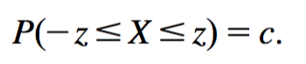
Mean and variance
Mean and variance for a Bernoulli trial: p, p (1–p)
Expected success rate f=S/N
Mean and variance for f : p, p (1–p)/N
For large enough N, f follows a Normal distribution
c% confidence interval [–z  X  z] for a random variable X is determined using:
For a symmetric distribution such as the normal distribution we have:

Slide 12
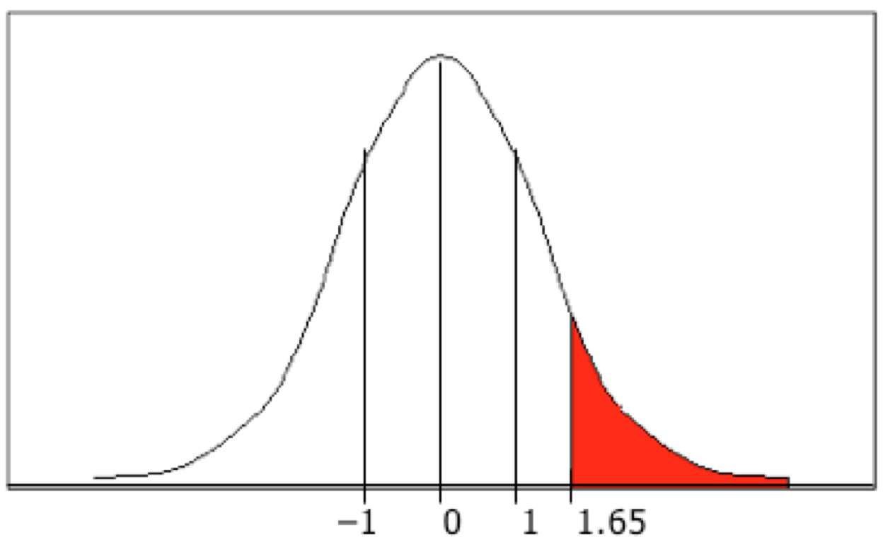
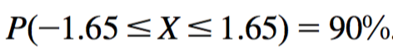
Confidence limits
Confidence limits for the normal distribution with 0 mean and a variance of 1:
Thus:
To use this we have to transform our random variable f to have 0 mean and unit variance
Pr[X ≥ z]
z
0.1%
3.09
0.5%
2.58
1%
2.33
5%
1.65
10%
1.28
20%
0.84
40%
0.25

Slide 13
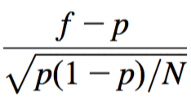
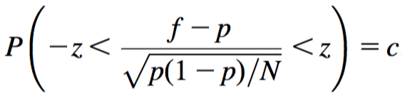
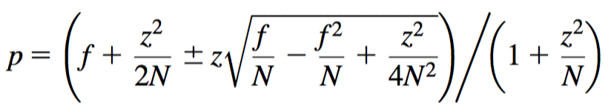
Transforming f
Transformed value for f : (i.e., subtract the mean and divide by the standard deviation)
Resulting equation:
Solving for p yields an expression for the confidence limits:

Slide 14
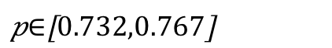


Examples
f = 75%, N = 1000, c = 80% (so that z = 1.28):
f = 75%, N = 100, c = 80% (so that z = 1.28):
Note that normal distribution assumption is only valid for large N (i.e., N > 100)
f = 75%, N = 10, c = 80% (so that z = 1.28): (should be taken with a grain of salt)
$$p∈\left[0.691,0.801\right]$$
$$p∈\left[0.549,0.881\right]$$

Slide 15
Holdout estimation
What should we do if we only have a single dataset?
The holdout method reserves a certain amount for testing and uses the remainder for training, after shuffling
Usually: one third for testing, the rest for training
Problem: the samples might not be representative
Example: class might be missing in the test data
Advanced version uses stratification
Ensures that each class is represented with approximately equal proportions in both subsets

Slide 16
Repeated holdout method
Holdout estimate can be made more reliable by repeating the process with different subsamples
In each iteration, a certain proportion is randomly selected for training (possibly with stratificiation)
The error rates on the different iterations are averaged to yield an overall error rate
This is called the repeated holdout method
Still not optimum: the different test sets overlap
Can we prevent overlapping?

Slide 17
Cross-validation
K-fold cross-validation avoids overlapping test sets
First step: split data into k subsets of equal size
Second step: use each subset in turn for testing, the remainder for training
This means the learning algorithm is applied to k different training sets
Often the subsets are stratified before the cross-validation is performed to yield stratified k-fold cross-validation
The error estimates are averaged to yield an overall error estimate; also, standard deviation is often computed
Alternatively, predictions and actual target values from the k folds are pooled to compute one estimate
Does not yield an estimate of standard deviation

Slide 18
More on cross-validation
Standard method for evaluation: stratified ten-fold cross-validation
Why ten?
Extensive experiments have shown that this is the best choice to get an accurate estimate
There is also some theoretical evidence for this
Stratification reduces the estimate’s variance
Even better: repeated stratified cross-validation
E.g., ten-fold cross-validation is repeated ten times and results are averaged (reduces the variance)

Slide 19
Leave-one-out cross-validation
Leave-one-out: a particular form of k-fold cross-validation:
Set number of folds to number of training instances
I.e., for n training instances, build classifier n times
Makes best use of the data
Involves no random subsampling
Very computationally expensive (exception: using lazy classifiers such as the nearest-neighbor classifier)

Slide 20
Leave-one-out CV and stratification
Disadvantage of Leave-one-out CV: stratification is not possible
It guarantees a non-stratified sample because there is only one instance in the test set!
Extreme example: random dataset split equally into two classes
Best inducer predicts majority class
50% accuracy on fresh data
Leave-one-out CV estimate gives 100% error!

Slide 21
The bootstrap
CV uses sampling without replacement
The same instance, once selected, can not be selected again for a particular training/test set
The bootstrap uses sampling with replacement to form the training set
Sample a dataset of n instances n times with replacement to form a new dataset of n instances
Use this data as the training set
Use the instances from the original dataset that do not occur in the new training set for testing

Slide 22
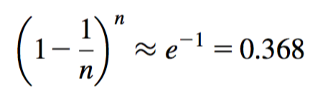
The 0.632 bootstrap
Also called the 0.632 bootstrap
A particular instance has a probability of 1–1/n of not being picked
Thus its probability of ending up in the test data is:
This means the training data will contain approximately 63.2% of the instances

Slide 23
Estimating error with the 0.632 bootstrap
The error estimate on the test data will be quite pessimistic
Trained on just ~63% of the instances
Idea: combine it with the resubstitution error:
The resubstitution error gets less weight than the error on the test data
Repeat process several times with different samples; average the results

Slide 24
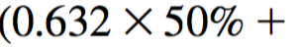
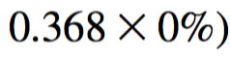
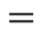
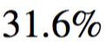
More on the bootstrap
Probably the best way of estimating performance for very small datasets
However, it has some problems
Consider the random dataset from above
A perfect memorizer will achieve 0% resubstitution error and ~50% error on test data
Bootstrap estimate for this classifier:
True expected error: 50%

Slide 25
Hyperparameter selection
Hyperparameter: parameter that can be tuned to optimize the performance of a learning algorithm
Different from basic parameter that is part of a model, such as a coefficient in a linear regression model
Example hyperparameter: k in the k-nearest neighbour classifier
We are not allowed to peek at the final test data to choose the value of this parameter
Adjusting the hyperparameter to the test data will lead to optimistic performance estimates on this test data!
Parameter tuning needs to be viewed as part of the learning algorithm and must be done using the training data only
But how to get a useful estimate of performance for different parameter values so that we can choose a value?
Answer: split the data into a smaller “training” set and a validation set” (normally, the data is shuffled first)
Build models using different values of k on the new, smaller training set and evaluate them on the validation set
Pick the best value of k and rebuild the model on the full original training set

Slide 26
Hyperparameters and cross-validation
Note that k-fold cross-validation runs k different train-test evaluations
The above parameter tuning process using validation sets must be applied separately to each of the k training sets!
This means that, when hyperparameter tuning is applied, k different hyperparameter values may be selected
This is OK: hyperparameter tuning is part of the learning process
Cross-validation evaluates the quality of the learning process, not the quality of a particular model
What to do when the training sets are very small, so that performance estimates on a validation set are unreliable?
We can use nested cross-validation (expensive!)
For each training set of the “outer” k-fold cross-validation, run “inner” p-fold cross-validations to choose the best hyperparameter value
Outer cross-validation is used to estimate quality of learning process
Inner cross-validations are used to choose hyperparameter values
Inner cross-validations are part of the learning process!

Slide 27
Comparing machine learning schemes
Frequent question: which of two learning schemes performs better?
Note: this is domain dependent!
Obvious way: compare 10-fold cross-validation estimates
Generally sufficient in applications (we do not loose if the chosen method is not truly better)
However, what about machine learning research?
Need to show convincingly that a particular method works better in a particular domain from which data is taken

Slide 28
Comparing learning schemes II
Want to show that scheme A is better than scheme B in a particular domain
For a given amount of training data (i.e., data size)
On average, across all possible training sets from that domain
Let's assume we have an infinite amount of data from the domain
Then, we can simply
sample infinitely many dataset of a specified size
obtain a cross-validation estimate on each dataset for each scheme
check if the mean accuracy for scheme A is better than the mean accuracy for scheme B

Slide 29
Paired t-test
In practice, we have limited data and a limited number of estimates for computing the mean
Student’s t-test tells us whether the means of two samples are significantly different
In our case the samples are cross-validation estimates, one for each dataset we have sampled
We can use a paired t-test because the individual samples are paired
The same cross-validation is applied twice, ensuring that all the training and test sets are exactly the same
William Gosset
Born: 1876 in Canterbury; Died: 1937 in Beaconsfield, England
Obtained a post as a chemist in the Guinness brewery in Dublin in 1899. Invented the t-test to handle small samples for quality control in brewing. Wrote under the name "Student".

Slide 30
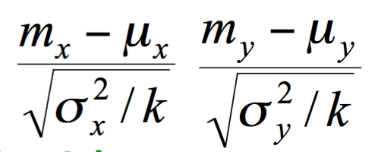
Distribution of the means
x₁ ,x₂ ,…, x_{k} and y₁ ,y₂ ,… ,y_{k} are the 2k samples for the k different datasets
m_{x} and m_{y} are the means
With enough samples, the mean of a set of independent samples is normally distributed (central limit theorem from statistics)
Estimated variances of the means are σ_{x}²/k and σ_{y}²/k
If μ_{x} and μ_{y} are the true means then are approximately normally distributed with mean 0, variance 1

Slide 31
Student’s distribution
With small sample sizes (k < 100) the mean follows Student’s distribution with k–1 degrees of freedom
Confidence limits from Student’s distribution:
9 degrees of freedom normal distribution
Pr[X ≥ z]
z
Pr[X ≥ z]
z
0.1%
4.30
0.1%
3.09
Assuming
we have
10 estimates
0.5%
3.25
0.5%
2.58
1%
2.82
1%
2.33
5%
1.83
5%
1.65
10%
1.38
10%
1.28
20%
0.88
20%
0.84

Slide 32
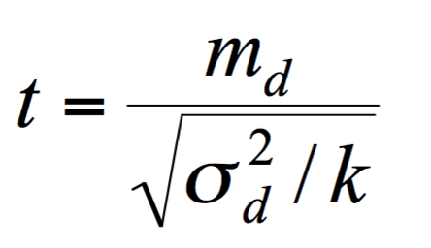
Distribution of the differences
Let m_{d} = m_{x} – m_{y}
The difference of the means (m_{d}) also has a Student’s distribution with k–1 degrees of freedom
Let σ_{d}² be the variance of the differences
The standardized version of m_{d} is called the t-statistic:
We use t to perform the paired t-test

Slide 33
Performing the test
Fix a significance level
If a difference is significant at the a% level, there is a (100-a)% chance that the true means differ
Divide the significance level by two because the test is two-tailed
I.e., the true difference can be +ve or – ve
Look up the value for z that corresponds to a/2
Compute the value of t based on the observed performance estimates for the schemes being compared
If t  –z or t z then the difference is significant
I.e., the null hypothesis (that the difference is zero) can be rejected

Slide 34
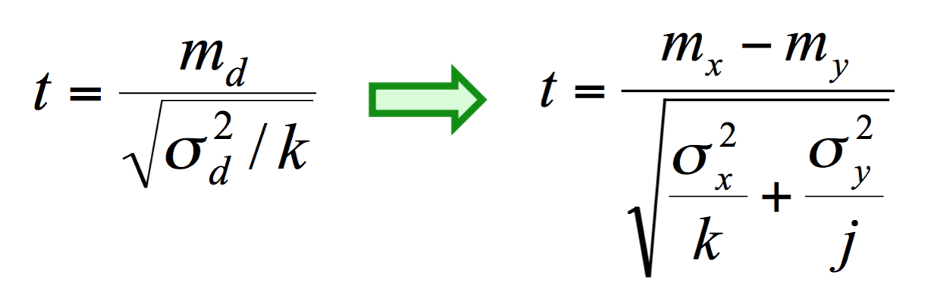
Unpaired observations
If the CV estimates are from different datasets, they are no longer paired (or maybe we have k estimates for one scheme, and j estimates for the other one)
Then we have to use an unpaired t-test with min(k , j) – 1 degrees of freedom
The statistic for the t-test becomes:

Slide 35
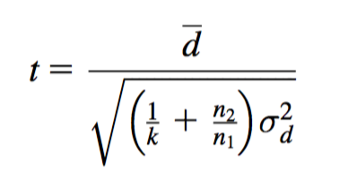
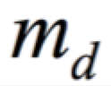
Dependent estimates
Unfortunately, we have assumed that we have enough data to create several datasets of the desired size
Need to re-use data if that is not the case
E.g., running cross-validations with different randomizations on the same data
Samples become dependent  insignificant differences can become significant
A heuristic test that tries to combat this is the corrected resampled t-test
Assume we use the repeated hold-out method with k runs, with n₁ instances for training and n₂ for testing
The new test statistic is:

Slide 36
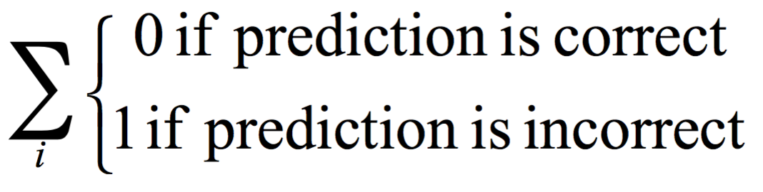
Predicting probabilities
Performance measure so far: success rate
Also called 0-1 loss function:
Most classifiers produces class probabilities
Depending on the application, we might want to check the accuracy of the probability estimates
0-1 loss is not the right thing to use in those cases

Slide 37
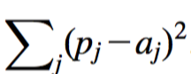
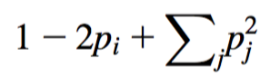
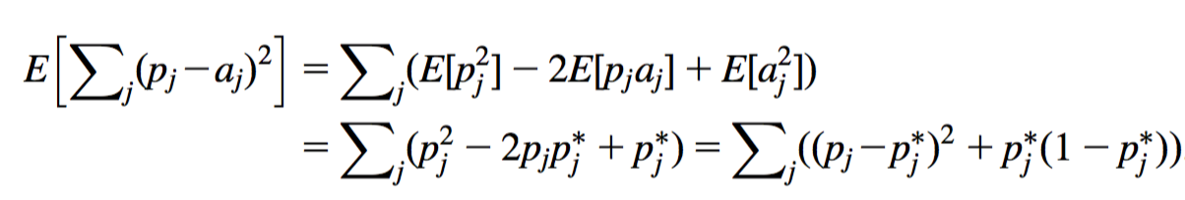
Quadratic loss function
p₁ … p_{k} are probability estimates for an instance
c is the index of the instance’s actual class
a₁ … a_{k} = 0, except for a_{c} which is 1
Quadratic loss is:
Want to minimize
Can show that the expected value of this is minimized when p_{j} = p_{j}*, where the latter are the true probabilities:

Slide 38
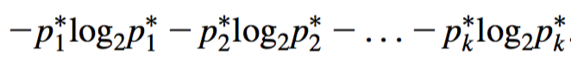
Informational loss function
The informational loss function is –log(p_{c}), where c is the index of the instance’s actual class
Number of bits required to communicate the actual class
Let p₁* … p_{k}* be the true class probabilities
Then the expected value for the loss function is:
Justification for informational loss is that this is minimized when p_{j} = p_{j}*:
Difficulty with informational loss : zero-frequency problem

Slide 39
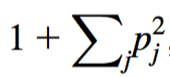
Discussion
Which loss function to choose?
Both encourage honesty
Quadratic loss function takes into account all class probability estimates for an instance
Informational loss focuses only on the probability estimate for the actual class
Quadratic loss is bounded by
it can never exceed 2
Informational loss can be infinite
Informational loss is related to the MDL principle [later]

Slide 40
Counting the cost
In practice, different types of classification errors often incur different costs
Examples:
Terrorist profiling: “Not a terrorist” correct 99.99…% of the time
Loan decisions
Oil-slick detection
Fault diagnosis
Promotional mailing

Slide 41
Counting the cost
The confusion matrix:
Different misclassification costs can be assigned to false positives and false negatives
There are many other types of cost!
E.g., cost of collecting training data
Predicted class
Yes
No
Actual class
Yes
True positive
False negative
No
False positive
True negative

Slide 42
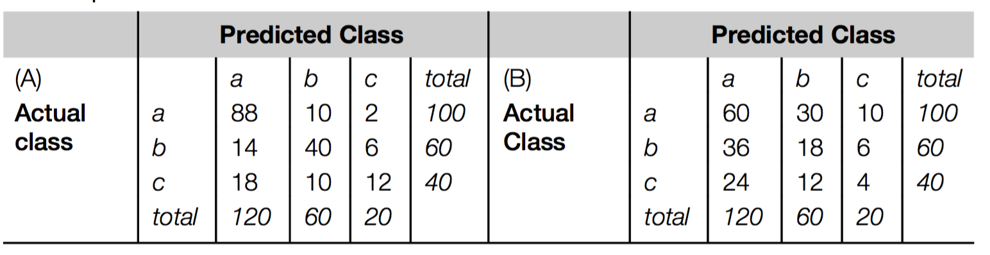
Aside: the kappa statistic
Two confusion matrices for a 3-class problem: actual predictor (left) vs. random predictor (right)
Number of successes: sum of entries in diagonal (D)
Kappa statistic: (success rate of actual predictor - success rate of random predictor) / (1 - success rate of random predictor)
Measures relative improvement on random predictor: 1 means perfect accuracy, 0 means we are doing no better than random

Slide 43
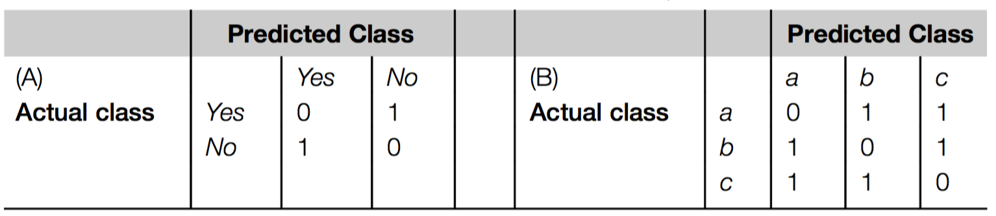
Classification with costs
Two cost matrices:
In cost-sensitive evaluation of classification methods, success rate is replaced by average cost per prediction
Cost is given by appropriate entry in the cost matrix

Slide 44
Cost-sensitive classification
Can take costs into account when making predictions
Basic idea: only predict high-cost class when very confident about prediction
Given: predicted class probabilities
Normally, we just predict the most likely class
Here, we should make the prediction that minimizes the expected cost
Expected cost: dot product of vector of class probabilities and appropriate column in cost matrix
Choose column (class) that minimizes expected cost
This is the minimum-expected cost approach to cost-sensitive classification

Slide 45
Cost-sensitive learning
So far we haven't taken costs into account at training time
Most learning schemes do not perform cost-sensitive learning
They generate the same classifier no matter what costs are assigned to the different classes
Example: standard decision tree learner
Simple methods for cost-sensitive learning:
Resampling of instances according to costs
Weighting of instances according to costs
Some schemes can take costs into account by varying a parameter, e.g., naïve Bayes

Slide 46
Lift charts
In practice, costs are rarely known
Decisions are usually made by comparing possible scenarios
Example: promotional mailout to 1,000,000 households
Mail to all; 0.1% respond (1000)
Data mining tool identifies subset of 100,000 most promising, 0.4% of these respond (400) 40% of responses for 10% of cost may pay off
Identify subset of 400,000 most promising, 0.2% respond (800)
A lift chart allows a visual comparison

Slide 47
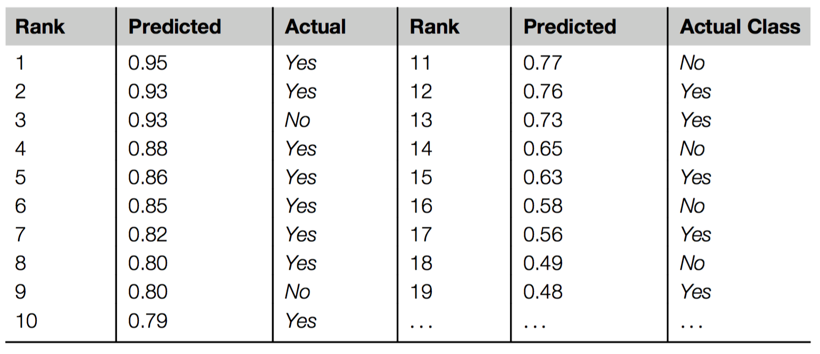
Generating a lift chart
Sort instances based on predicted probability of being positive:
x axis in lift chart is sample size for each probability threshold
y axis is number of true positives above threshold

Slide 48
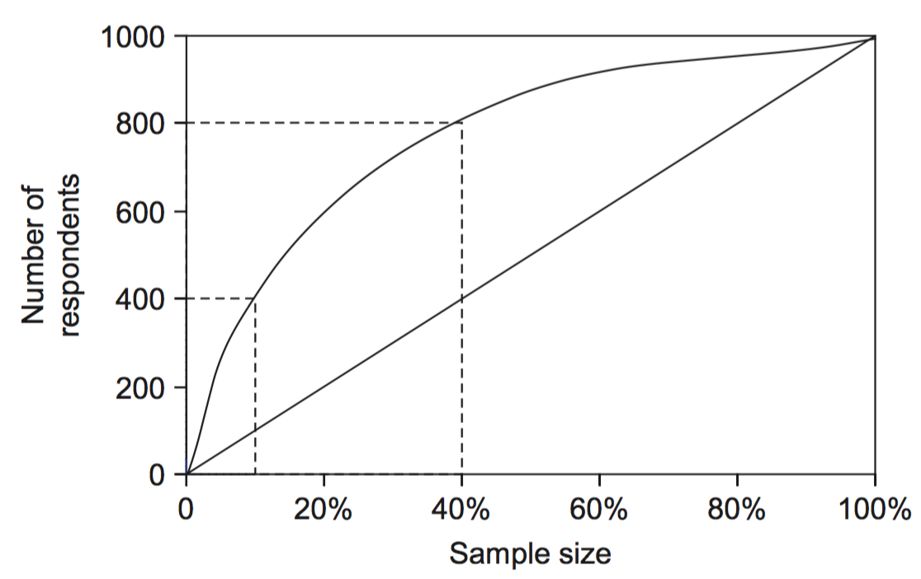
A hypothetical lift chart
40% of responses for 10% of cost
80% of responses for 40% of cost

Slide 49
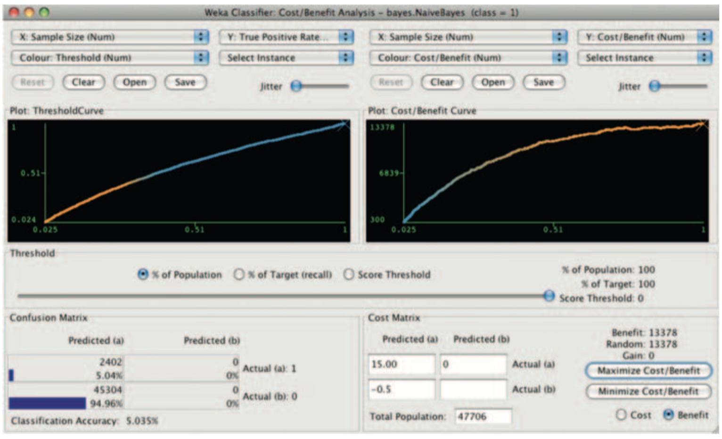
Interactive cost-benefit analysis: Example I

Slide 50
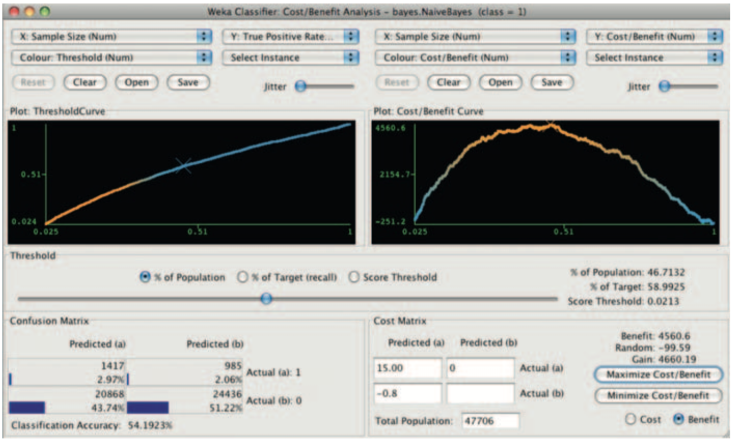
Interactive cost-benefit analysis: Example II

Slide 51
ROC curves
ROC curves are similar to lift charts
Stands for “receiver operating characteristic”
Used in signal detection to show tradeoff between hit rate and false alarm rate over noisy channel
Differences to lift chart:
y axis shows percentage of true positives in sample rather than absolute number
x axis shows percentage of false positives in sample rather than sample size

Slide 52
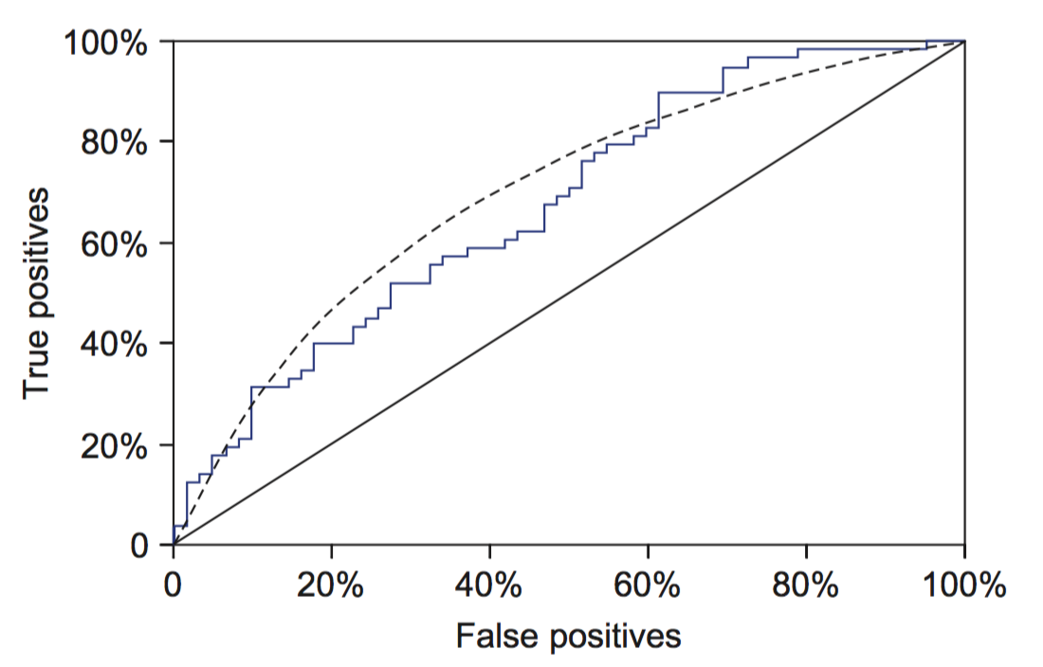
A sample ROC curve
Jagged curve—one set of test data
Smoother curve—use cross-validation

Slide 53
Cross-validation and ROC curves
Simple method of getting a ROC curve using cross-validation:
Collect probabilities for instances in test folds
Sort instances according to probabilities
This method is implemented in WEKA
However, this is just one possibility
Another possibility is to generate an ROC curve for each fold and average them

Slide 54
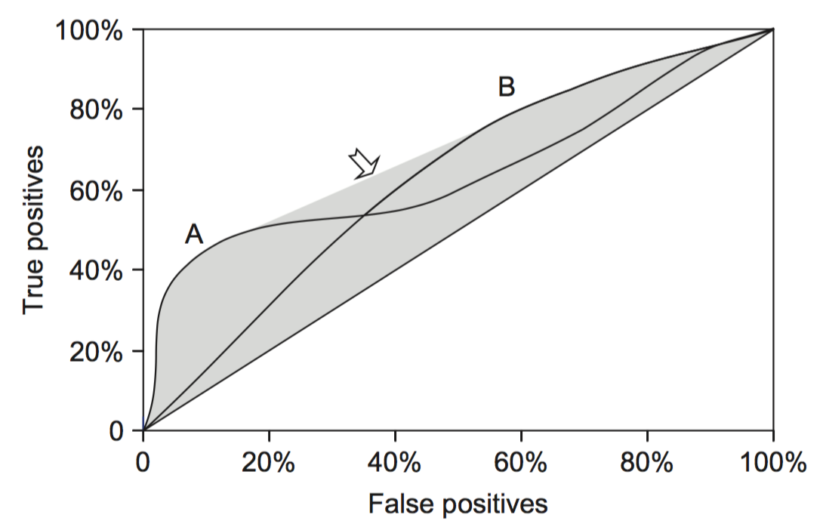
ROC curves for two schemes
For a small, focused sample, use method A
For a larger one, use method B
Inbetween, choose between A and B with appropriate probabilities

Slide 55
The convex hull
Given two learning schemes we can achieve any point on the convex hull!
TP and FP rates for scheme 1: t₁ and f₁
TP and FP rates for scheme 2: t₂ and f₂
If scheme 1 is used to predict 100 × q % of the cases and scheme 2 for the rest, then
TP rate for combined scheme: q × t₁ + (1-q) × t₂
FP rate for combined scheme: q × f₁+(1-q) × f₂

Slide 56
More measures...
Percentage of retrieved documents that are relevant: precision=TP/(TP+FP)
Percentage of relevant documents that are returned: recall =TP/(TP+FN)
Precision/recall curves have hyperbolic shape
Summary measures: average precision at 20%, 50% and 80% recall (three-point average recall)
F-measure=(2 × recall × precision)/(recall+precision)
sensitivity × specificity = (TP / (TP + FN)) × (TN / (FP + TN))
Area under the ROC curve (AUC): probability that randomly chosen positive instance is ranked above randomly chosen negative one

Slide 57
Summary of some measures
Domain
Plot
Explanation
Lift chart
Marketing
TP
Subset size
TP
(TP+FP)/(TP+FP+TN+FN)
ROC curve
Communications
TP rate
FP rate
TP/(TP+FN)
FP/(FP+TN)
Recall-precision curve
Information retrieval
Recall
Precision
TP/(TP+FN)
TP/(TP+FP)

Slide 58
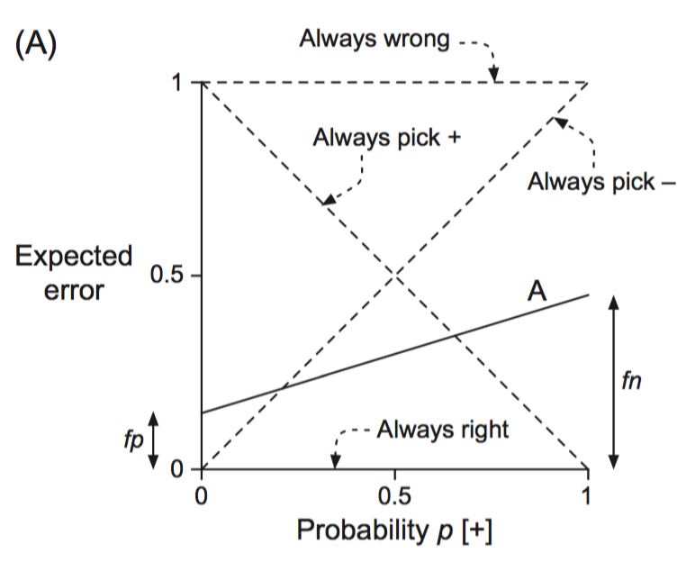
Cost curves
Cost curves plot expected costs directly
Example for case with uniform costs (i.e., error):

Slide 59
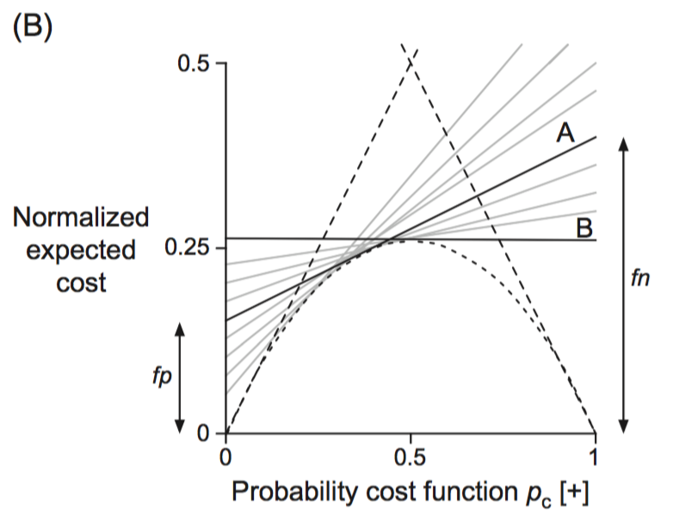
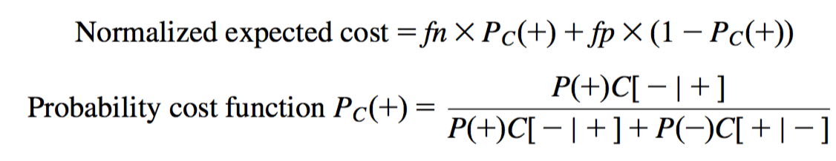
Cost curves: example with costs

Slide 60
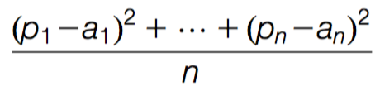
Evaluating numeric prediction
Same strategies: independent test set, cross-validation, significance tests, etc.
Difference: error measures
Actual target values: a₁ a₂ …a_{n}
Predicted target values: p₁ p₂ … p_{n}
Most popular measure: mean-squared error
Easy to manipulate mathematically

Slide 61
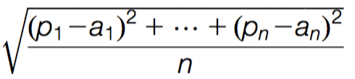
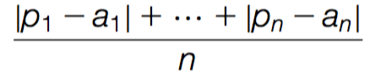
Other measures
The root mean-squared error :
The mean absolute error is less sensitive to outliers than the mean-squared error:
Sometimes relative error values are more appropriate (e.g. 10% for an error of 50 when predicting 500)

Slide 62
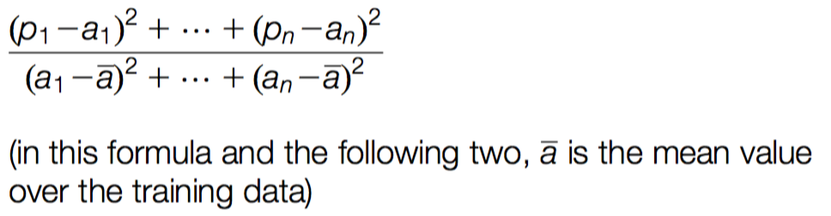
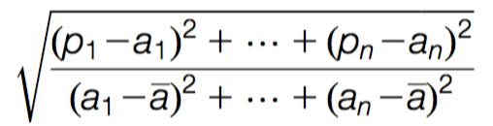
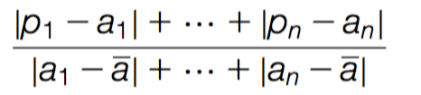
Improvement on the mean
How much does the scheme improve on simply predicting the average?
The relative squared error is:
The root relative squared error and the relative absolute error are:

Slide 63
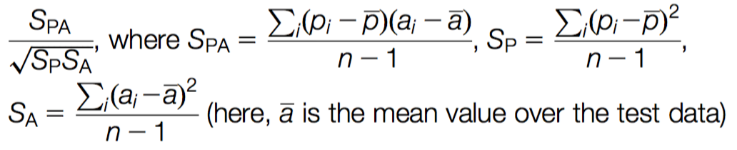
Correlation coefficient
Measures the statistical correlation between the predicted values and the actual values
Scale independent, between –1 and +1
Good performance leads to large values!

Slide 64
Which measure?
Best to look at all of them
Often it doesn’t matter
Example:
A
B
C
D
Root mean-squared error
67.8
91.7
63.3
57.4
Mean absolute error
41.3
38.5
33.4
29.2
Root rel squared error
42.2%
57.2%
39.4%
35.8%
Relative absolute error
43.1%
40.1%
34.8%
30.4%
Correlation coefficient
0.88
0.88
0.89
0.91
D best
C second-best
A, B arguable

Slide 65
The MDL principle
MDL stands for minimum description length
The description length is defined as: space required to describe a theory + space required to describe the theory’s mistakes
In our case the theory is the classifier and the mistakes are the errors on the training data
Aim: we seek a classifier with minimal DL
MDL principle is a model selection criterion
Enables us to choose a classifier of an appropriate complexity to combat overfitting

Slide 66
Model selection criteria
Model selection criteria attempt to find a good compromise between:
The complexity of a model
Its prediction accuracy on the training data
Reasoning: a good model is a simple model that achieves high accuracy on the given data
Also known as Occam’s Razor : the best theory is the smallest one that describes all the facts
William of Ockham, born in the village of Ockham in Surrey (England) about 1285, was the most influential philosopher of the 14th century and a controversial theologian.

Slide 67
Elegance vs. errors
Theory 1: very simple, elegant theory that explains the data almost perfectly
Theory 2: significantly more complex theory that reproduces the data without mistakes
Theory 1 is probably preferable
Classical example: Kepler’s three laws on planetary motion
Less accurate than Copernicus’s latest refinement of the Ptolemaic theory of epicycles on the data available at the time

Slide 68
MDL and compression
MDL principle relates to data compression:
The best theory is the one that compresses the data the most
In supervised learning, to compress the labels of a dataset, we generate a model and then store the model and its mistakes
We need to compute (a) the size of the model, and (b) the space needed to encode the errors
(b) easy: use the informational loss function
(a) need a method to encode the model

Slide 69
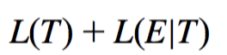
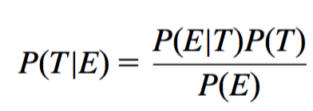
MDL and Bayes’s theorem
L[T]=“length” of the theory
L[E|T]=training set encoded wrt the theory
Description length=
Bayes’s theorem can be used to obtain the a posteriori probability of a theory given the data:
Equivalent to:
constant

Slide 70
MDL and MAP
MAP stands for maximum a posteriori probability
Probabilistic approach to model selection
Finding the MAP theory is the same as finding the MDL theory, assuming coding scheme corresponds to prior
Difficult bit in applying the MAP principle: determining the prior probability P(T) of the theory
Corresponds to difficult part in applying the MDL principle: coding scheme for the theory
Correspondence is clear: if we know a priori that a particular theory is more likely, we need fewer bits to encode it

Slide 71
Discussion of MDL principle
Advantage: makes full use of the training data when selecting a model
Disadvantage 1: appropriate coding scheme/prior probabilities for theories are crucial
Disadvantage 2: no guarantee that the MDL theory is the one which minimizes the expected error
Note: Occam’s Razor is an axiom!
Epicurus’s principle of multiple explanations: keep all theories that are consistent with the data

Slide 72
MDL and clustering
Model selection in clustering: finding the most appropriate number of clusters to model the data
Description length of theory: bits needed to encode the clusters
e.g., cluster centers
Description length of data given theory: encode cluster membership and position relative to cluster
e.g., distance to cluster center
Works if coding scheme uses less code space for small numbers than for large ones
With nominal attributes, must communicate probability distributions for each cluster

Slide 73
Using a validation set for model selection
MDL principle is one example of a model selection criterion
Model selection: finding the right model complexity
Classic model selection problem in statistics:
Finding the subset of attributes to use in a linear regression model (yes, linear regression can overfit!)
Other model selection problems: choosing the size of a decision tree or artificial neural network
Many model selection criteria exist, based on a variety of theoretical assumptions
Simple model selection approach: use a validation set
Use the model complexity that yields best performance on the validation set
Alternative approach when data is scarce: internal cross-validation

